Slide 1
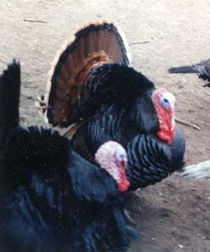
227 - Bronze

Slide 2
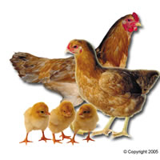
228 - Buff Cornish Chicken

Slide 3
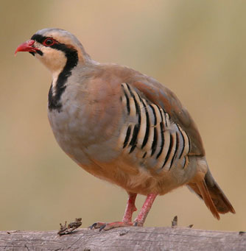
229 - Chukar Partridge

Slide 4
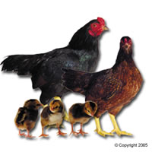
230 - Dark Cornish Chicken

Slide 5
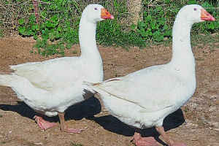
231 - Embden Geese
Notes:
Most common meat geese

Slide 6
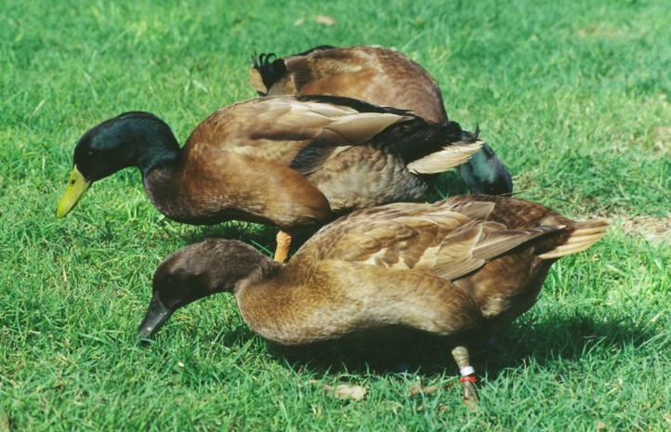
232 - Khaki Campbell

Slide 7
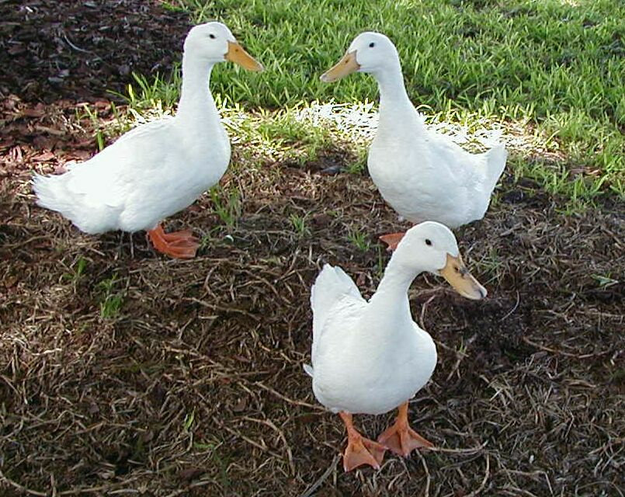
233 - Pekin Duck

Slide 8
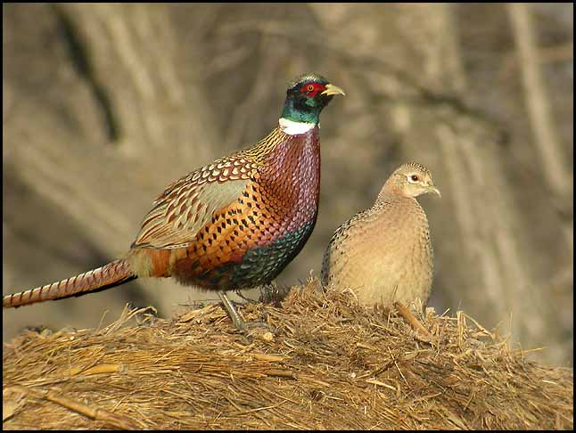
234 - Pheasants

Slide 9
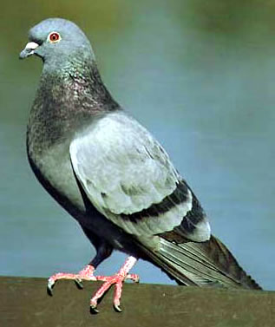
235 - Pigeons

Slide 10
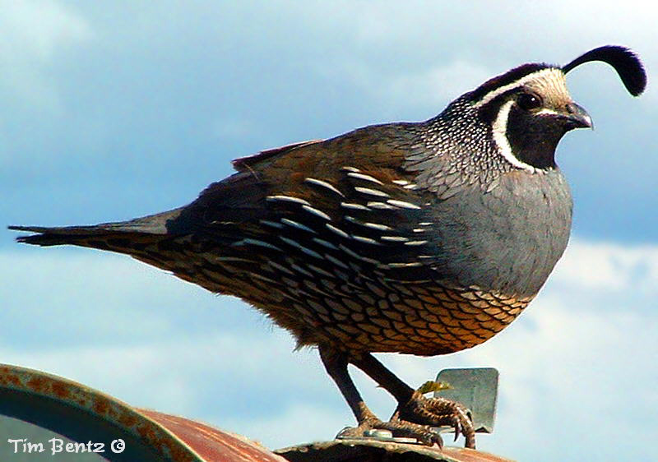
236 - Quail

Slide 11
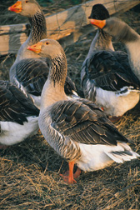
237 - Toulouse Geese

Slide 12
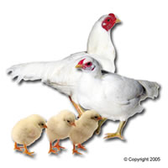
238 - White Cornish Chicken

Slide 13
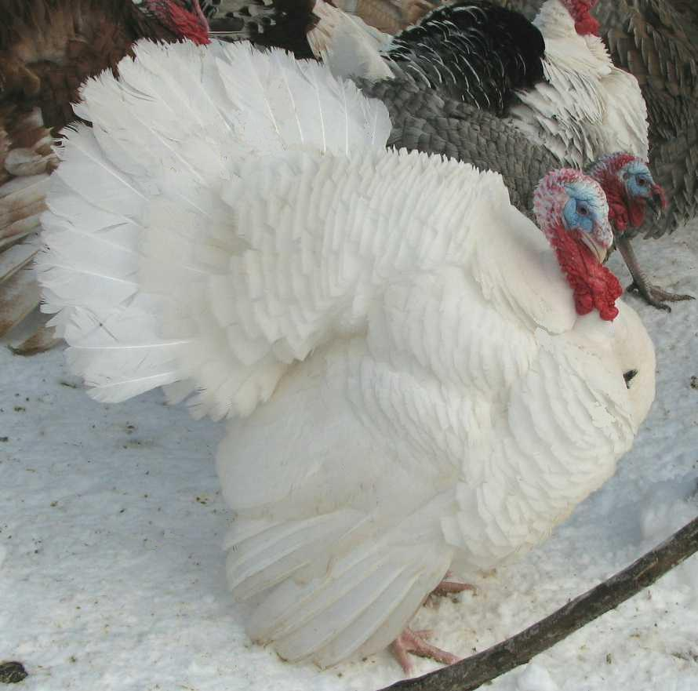
239 - White Holland

Slide 14
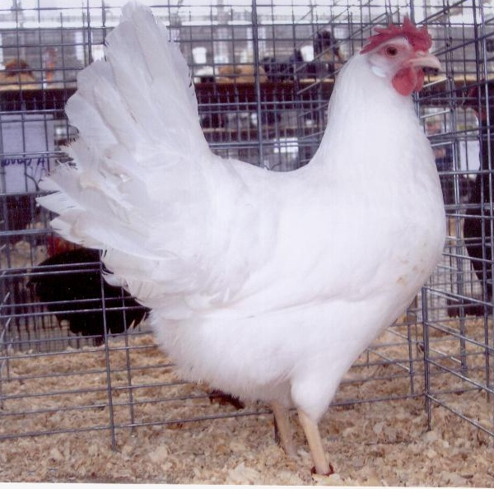
240 - White Leghorn

